Slide 1

Root-x Secure: Safeguarding the Digital Landscape
dd
by dima dima

Slide 2
The Need for Comprehensive Cybersecurity
Today's digital world is increasingly vulnerable to cyber threats. Attacks on websites, financial institutions, and software are becoming more frequent and sophisticated.
Data breaches and DDoS attacks can have devastating consequences, including financial loss, reputational damage, and legal liabilities.

Slide 3

Encryption and Monitoring: Our Approach
Encryption
Monitoring
We use advanced encryption techniques to safeguard sensitive data, ensuring its confidentiality and integrity.
Our 24/7 monitoring systems actively detect and respond to suspicious activity, providing real-time protection against threats.

Slide 4
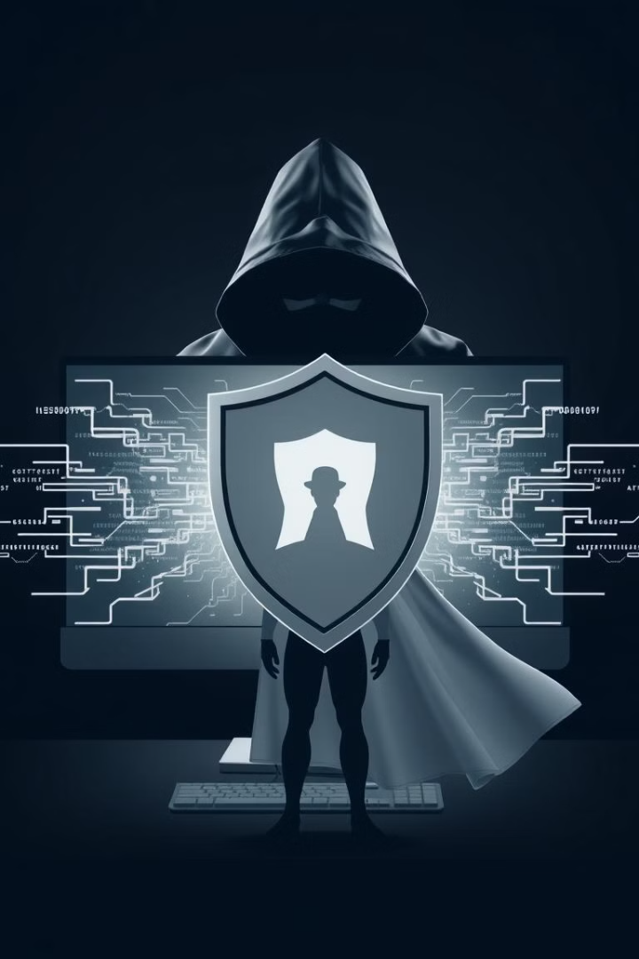



Mitigating Cyber Attacks: Strategies and Solutions
Threat Intelligence
We stay ahead of the curve by continuously monitoring and analyzing emerging threats.
Vulnerability Assessment
Regular vulnerability assessments identify and remediate weaknesses in your systems and applications.
Incident Response
Our team is equipped to swiftly respond to incidents, minimizing damage and restoring operations.

Slide 5
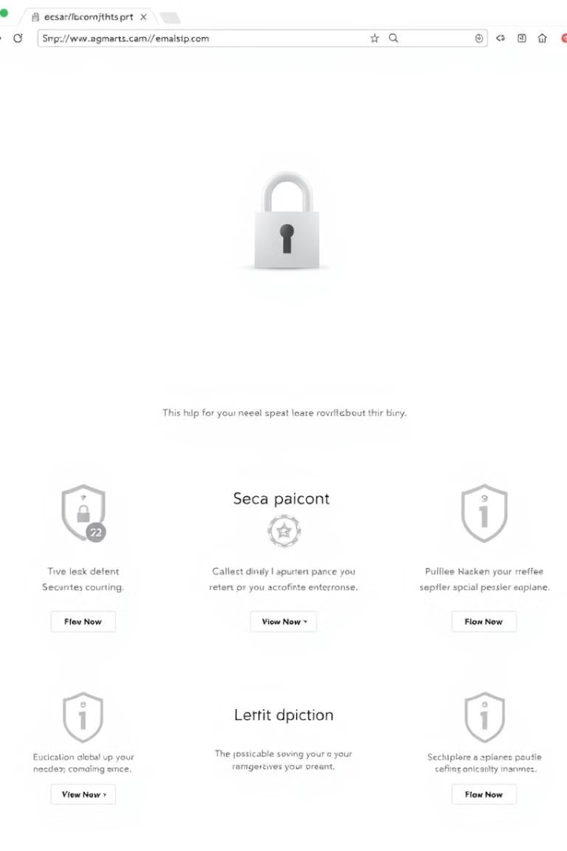



Secure Website Development: Best Practices
Secure Coding Practices
Secure Authentication
We employ rigorous coding standards to minimize vulnerabilities and enhance security.
Strong authentication measures safeguard user accounts and prevent unauthorized access.
Web Application Firewalls
We deploy web application firewalls to protect against common attacks and malicious code.

Slide 6

Proactive Threat Monitoring and Incident Response
1
Continuous Monitoring
Our 24/7 security operations center constantly monitors your systems for suspicious activity.
2
Automated Alerts
Automated alerts trigger immediate responses, allowing us to act swiftly in case of a breach.
3
Incident Response Plan
We have a comprehensive incident response plan in place to minimize downtime and mitigate damage.

Slide 7

Compliance and Regulatory Adherence
Industry Standards
Compliance Audits
Data Protection
We adhere to industry best practices and regulatory standards, ensuring data privacy and security.
We conduct regular compliance audits to ensure our security measures meet the highest standards.
We prioritize the protection of sensitive information, ensuring compliance with data privacy regulations.

Slide 8



Empowering Clients: Tailored Security Services
Needs Assessment
1
We conduct a thorough assessment of your security needs to tailor a customized solution.
Security Solutions
2
We offer a range of security solutions to address your specific vulnerabilities and risks.
Ongoing Support
3
We provide ongoing support and maintenance to ensure your security posture remains robust.

Slide 9



Code of Ethics and Conduct
Integrity
Confidentiality
Transparency
Upholding the highest ethical standards in all our interactions.
Client data and information are treated with the utmost confidentiality.
Open communication and transparent practices build trust with our clients.

Slide 10

Ethical Guidelines
1
2
Data Privacy
Responsible Disclosure
We prioritize public interest and data privacy and comply with relevant regulations.
We encourage responsible disclosure of vulnerabilities.
3
Security Awareness
We promote security awareness among our clients and employees.

